Slide 2
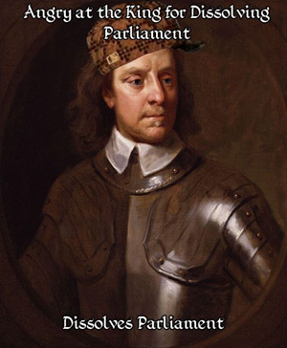

Slide 3
The English Civil War and Glorious Revolution

Slide 4
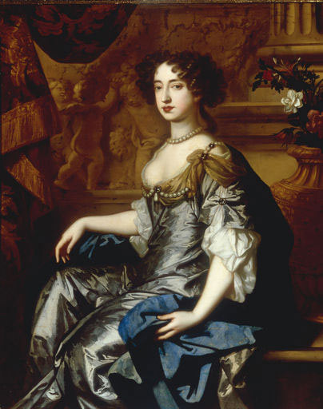
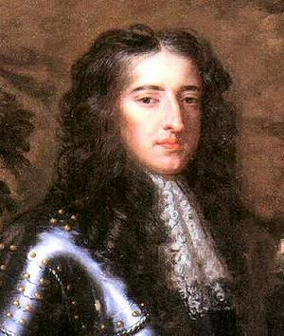
STUART MONARCHS OF ENGLAND
William and Mary would rule as joint monarchs
James I
Charles I
ENGLISH CIVIL WAR
Oliver Cromwell, Lord Protector
Charles II
James II
William III
Anne
(Protestant)
James
(Catholic)
Mary II

Slide 5
English Civil War and Glorious Revolution
Directions:
You will be divided up into 6 groups
Each group gets a topic that deals with one important aspect of the English Civil War and Glorious Revolution
Your task is to create a 5-8 minute presentation discussing the important aspects of your topic using the sheet provided

Slide 6
English Civil War and Glorious Revolution Groups
Causes of the English Civil War
Events of the Civil War up to the take Execution of the Charles I
Execution of the King and Oliver Cromwell’s Rule and Death
Post-Cromwell and the Restoration of the Monarchy, Reign of Charles II and James II
The Causes of the Glorious Revolution
Outcome of the Glorious Revolution including the English Bill of Rights

Slide 9
English Civil War – Glorious Revolution Discussion
What caused the English Civil War?
What is your opinion of Oliver Cromwell as a leader, and as a man?
How was James I so different than Elizabeth, or the other Tudors?
Do you think Cromwell had a right to declare himself dictator?

Slide 10
Your job:
Count off in your group (1-2-3-4)
Question 1 will be answered by 1s and 2s.
Questions 2 will be answered by 3s and 4s.
Write a full opening paragraph to your question.
With the others in your group, find the “best” example. It should:
Answer all parts of the question
Create a claim, and start to prove the claim
Be very VERY clear and analytical

