Slide 1
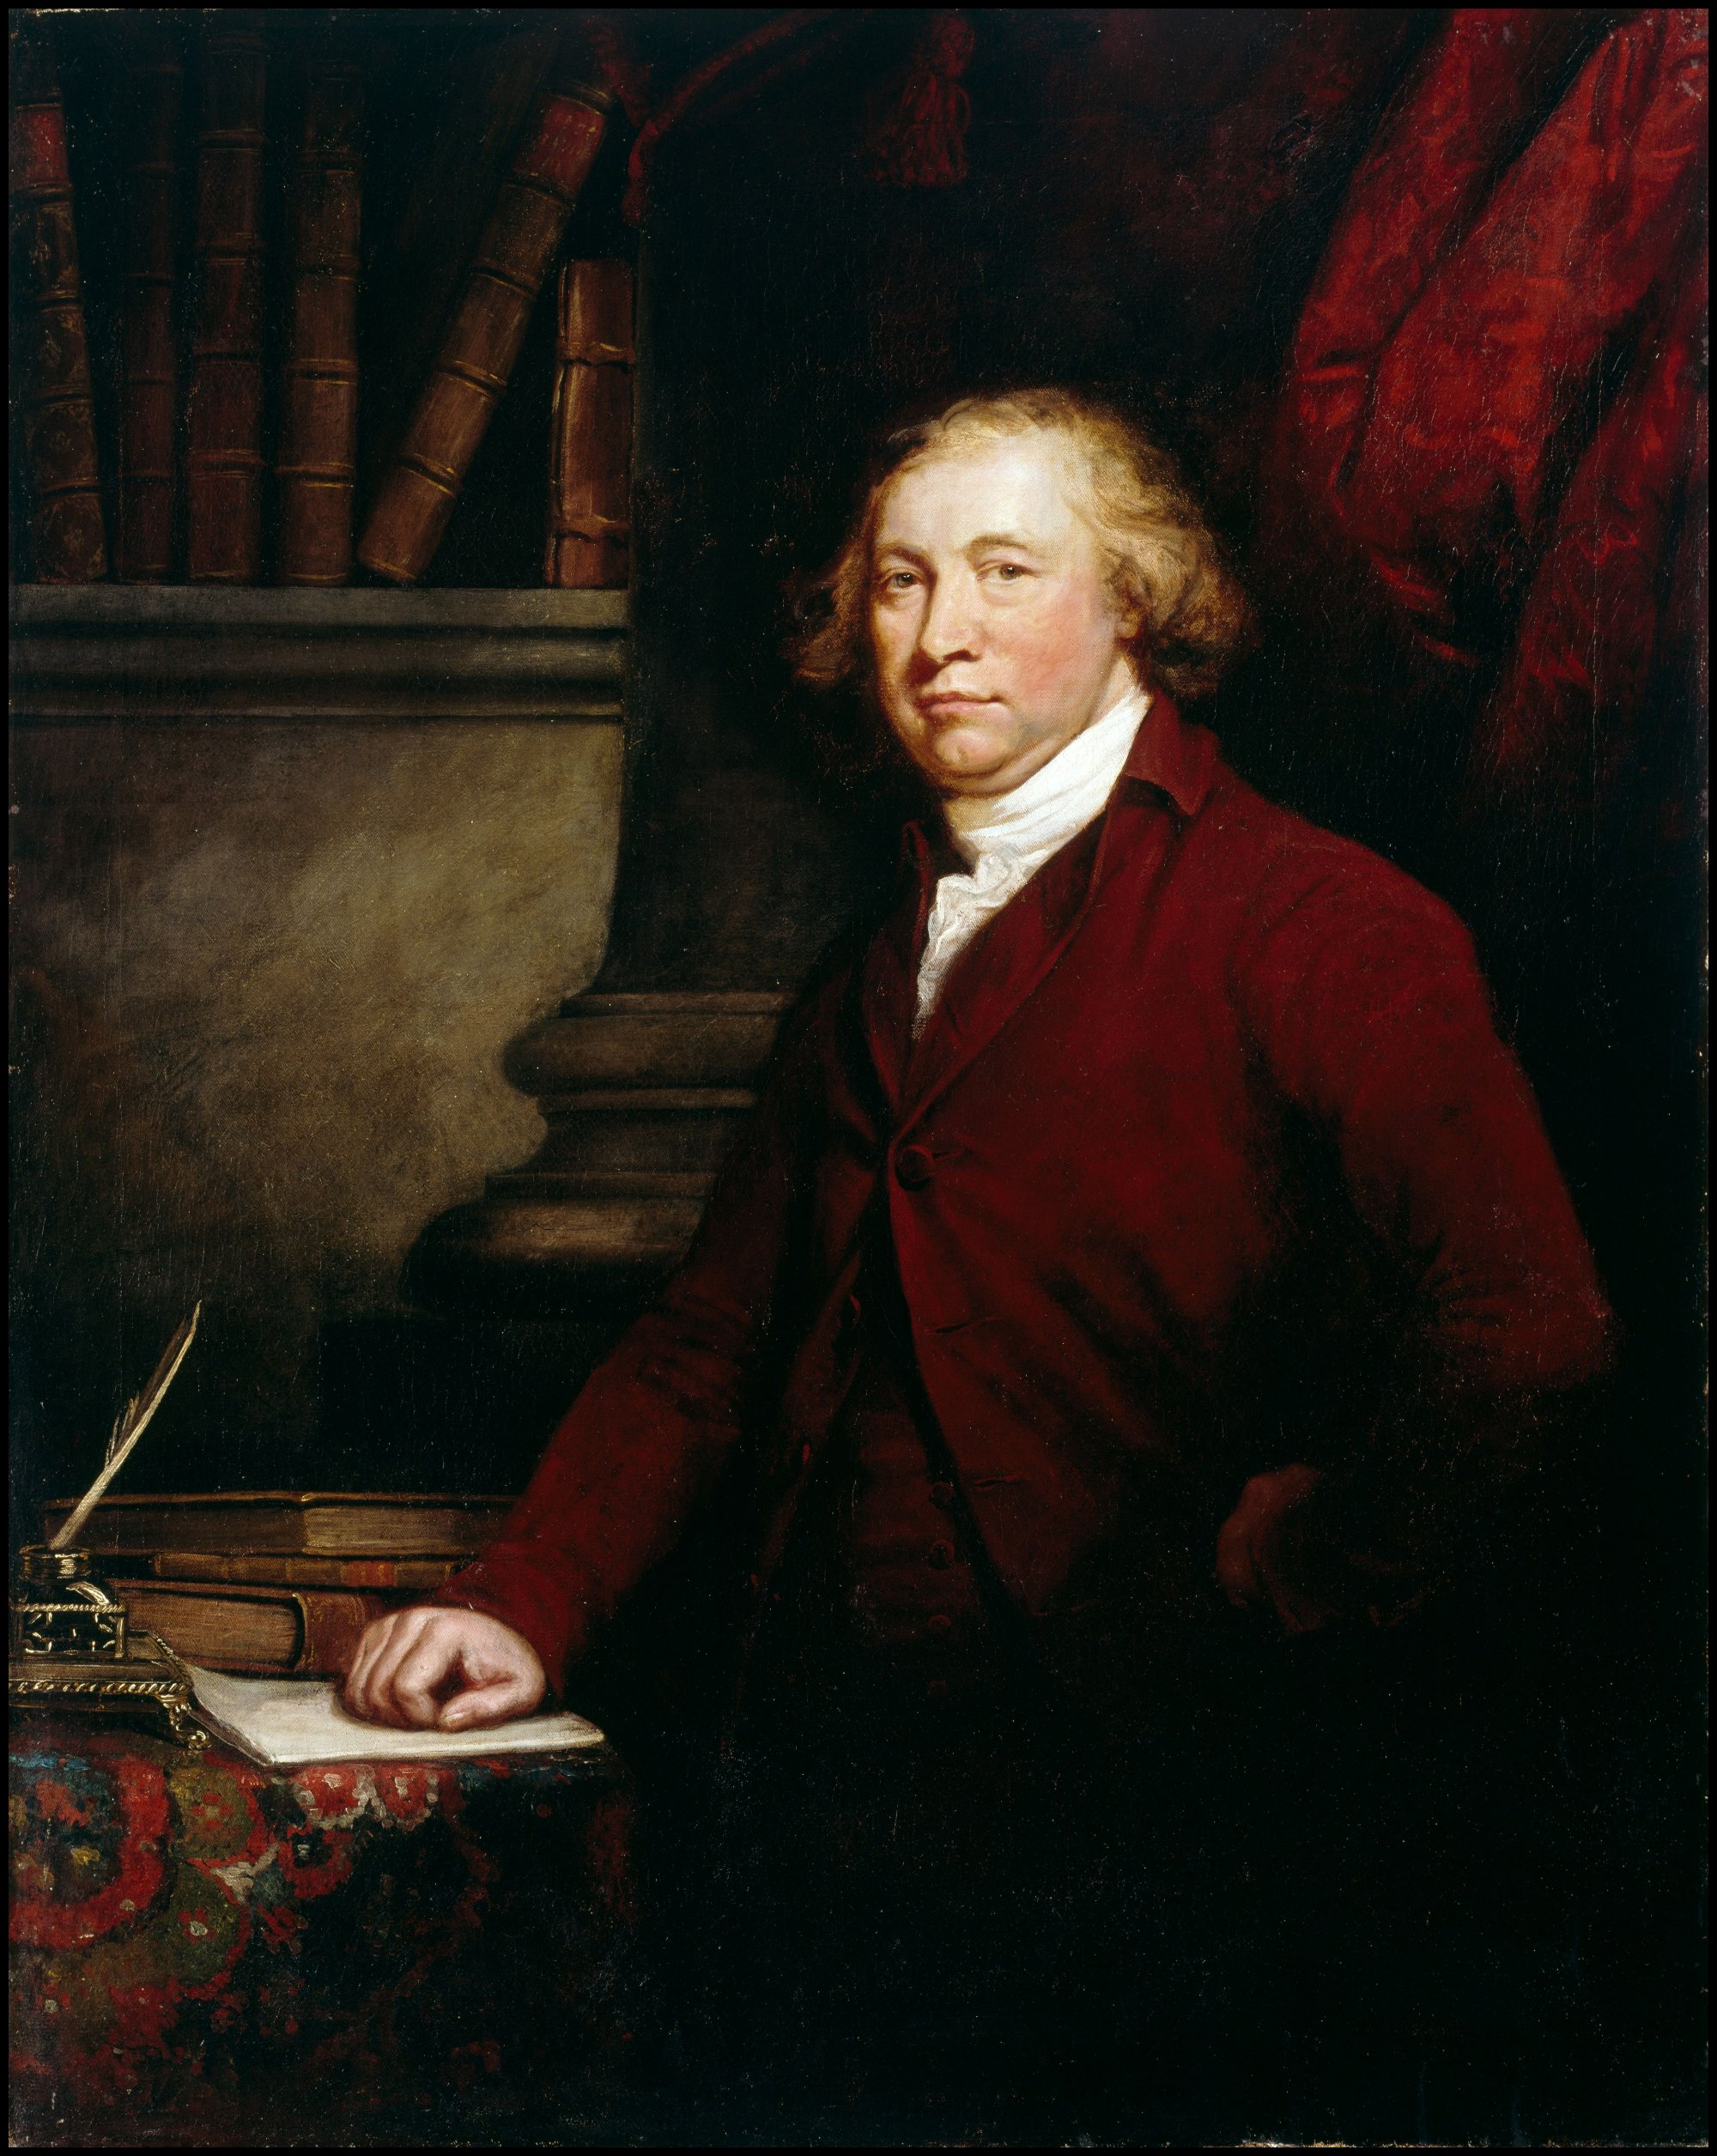
Edmund Burke
Lived 1730-1797, served in English Parliament from 1766 to 1794 in the liberal Whig Party
His ideas are foundational ideas for conservatism (despite his being part of the liberal Whig party)
Most well known for supporting the cause of the American colonists in their war for independence and for denouncing the French Revolutionaries early on
-“People will not look forward to posterity, who never look backward to their ancestors”.

Slide 2
The Assignment
Either on your own or with ONE other person read through the Burke document (it is a challenging read)
Next, respond to the questions at the end on a piece of loose-leaf paper that you can turn in.
The reading is a class copy, but I have extra if needed and it is also on the website if you need more time

